Slide 1

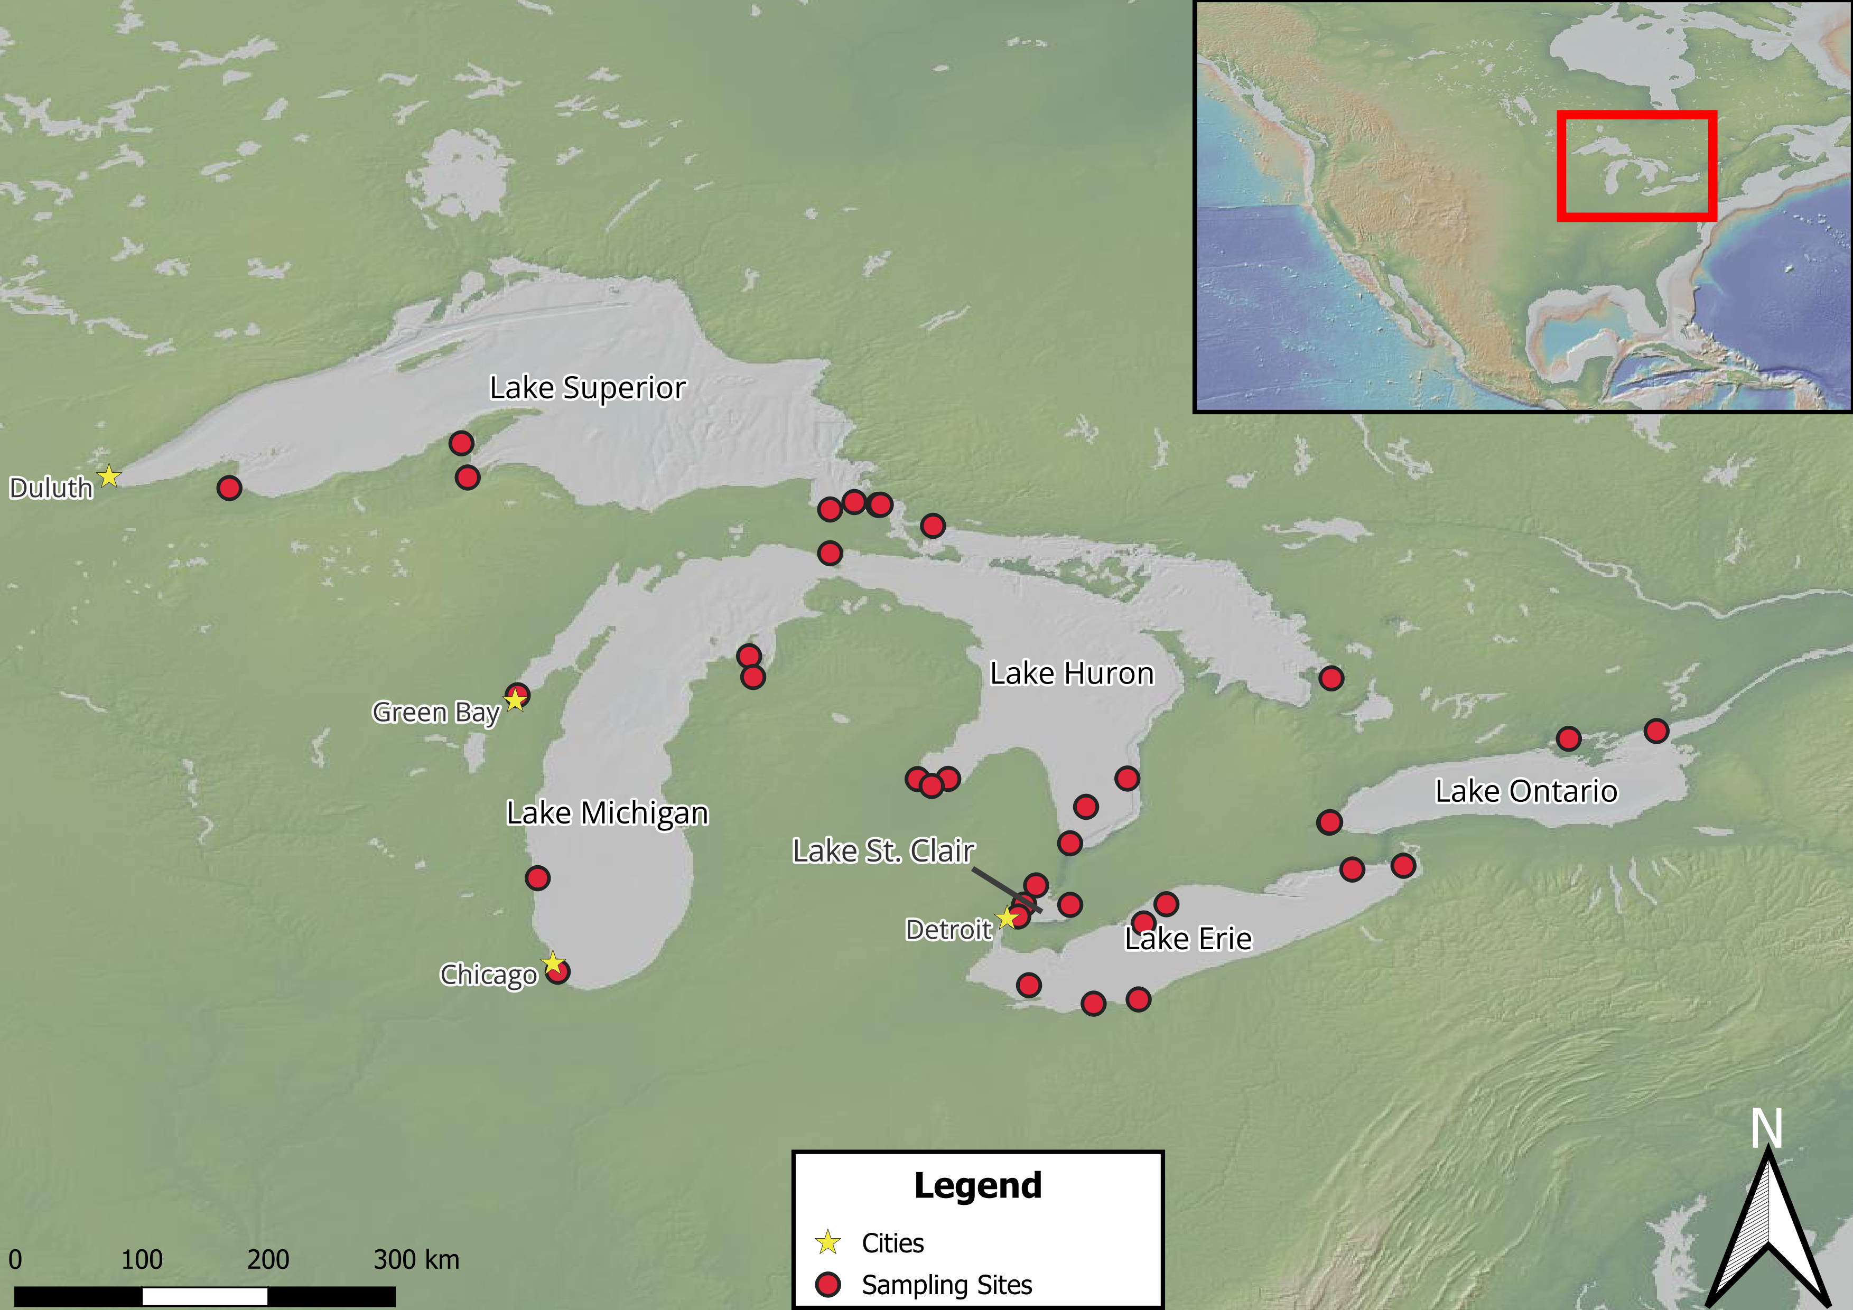
Seasonal Variation in Microbial Community Dynamics and Organic Matter in the Great Lakes
Connor O’Loughlin¹, Gord Paterson¹, Nicole Wagner², Hunter Carrick³, Jonathan Doubek⁴, Donald Uzarski³, Trista J. Vick-Majors¹, with the Winter Grab Network
¹Michigan Technological University, ²Oakland University, ³Central Michigan University, ⁴Lake Superior State University
Introduction
Winter has been regarded as a period of relative dormancy in limnetic systems¹, characterized by low biological activity.
Recent work has shown that microbial communities remain active during winter², and important biogeochemical processes still occur
We present work aimed at understanding the microbial ecology of the Laurentian Great Lakes during winter.
Dissolved Organic Carbon Concentration
Seasonal and Annual Bacterial Production
Hypotheses
Microbial activity will vary across years, lakes, and seasons, with a depressed level of activity in winter, marked by a relative decrease in bacterial production.
Dissolved organic carbon (DOC) and organic matter will vary across seasons and between lakes.
Terrestrial inputs of DOM will be higher in spring and summer across lakes, as indicated by a higher specific ultraviolet absorbance at 254 nm (SUVA254).
Figure 4. A series of scatter plots showing the relationship between leucine and thymidine uptake for each lake. Season and year are denoted by shape and color, respectively. A larger uptake of leucine relative to thymidine suggests bacterial maintenance over bacterial growth The dotted grey line shows a 1:1 relationship.
Figure 1. A bar chart showing mean DOC concentration by year and season for each lake. The error bars represent the standard error with the sample size shown above. Data for winter 2025 has not be analyzed yet and therefore not shown.
DOM Quality in Laurentian Great Lakes
Conclusions
Lake Huron DOC concentrations were unusually high in winter, however the sample size is small. Summer DOC was consistently the highest across lakes (Figure 1).
BIX values were more variable between lakes and seasons, indicating differences in autotrophic productivity linked to season and lake (Figure 2).
HIX remained relatively stable year-round, with each lake displaying unique shifts in HIX, and summer often having the lowest values (Figure 2).
In most lakes, winter had a higher SUVA254 value (Figure 3).
Winter 2025 bacterial production was lowest across lakes. Summer and spring bacterial production were the highest, with a distinct shift to bacterial growth (Figure 4).
Methods
Bacterial production was measured via incubations with tritiated leucine and thymidine.
Dissolved organic matter (DOM) was characterized using via fluorescence excitation-emission matrix spectroscopy.
Raw water samples were used to measure DOC.
Figure 2. Bar charts showing average Humification index (HIX; A) and Biological index (BIX; B) values by year and season for each lake. The error bars represent the standard error of the mean with sample size shown above each bar. Higher HIX values indicate extent of humification, and higher BIX values indicate autotrophic productivity³.
Terrestrial DOM Inputs
Future Directions
Make a mixed effect linear model that includes biological, chemical, and physical parameters to predict microbial activity.
Incorporate winter 2025 data into analyses.
Use robust statistical tests like Kruskal-Wallis t-test to analyze difference of means (due to small sample sizes)
Acknowledgements
We would like to thank Maci Quintanilla, Garrett Lukosavich, Mitch Kehne, Allen Cureton, Mari Leland, K.M. Shafi, and An Nguyen for assistance with sample collection and lab work, the Great Lakes Research Center for providing logistical and financial support, and the Great Lakes Winter Network for support. Special thanks to the Winter Grab network for participating in sample collection and analysis. This work is supported by a Michigan Sea Grant award to TVM (SUBK00020867).
Literature Cited
1. Ozersky, T., Bramburger, A. J., Elgin, A. K., Vanderploeg, H. A., Wang, J., Austin, J. A., Carrick, H. J., Chavarie, L., Depew, D. C., Fisk, A. T., Hampton, S. E., Hinchey, E. K., North, R. L., Wells, M. G., Xenopoulos, M. A., Coleman, M. L., Duhaime, M. B., Fujisaki-Manome, A., McKay, R. M., … Zastepa, A. (2021). The Changing Face of Winter: Lessons and Questions From the Laurentian Great Lakes. Journal of Geophysical Research: Biogeosciences, 126(6), e2021JG006247. https://doi.org/10.1029/2021JG006247
2. Hébert, M.-P., Beisner, B. E., Rautio, M., & Fussmann, G. F. (2021). Warming winters in lakes: Later ice onset promotes consumer overwintering and shapes springtime planktonic food webs. Proceedings of the National Academy of Sciences, 118(48), e2114840118. https://doi.org/10.1073/pnas.2114840118
3. Hansen, A., Fleck, J., Kraus, T., Downing, B., Dessonneck, T., & Bergamaschi, B. (2018). Procedures for Using the Horiba Scientific Aqualog Flourometer to Measure Absorbance and Flourescence from Dissolved Organic Matter (Open-File Report 1096; Open-File Report, Issue 1096, p. 42). USGS.
Figure 1. This map shows sites sampled from February 2024 to February 2025. A geographical reference of the Laurentian Great Lakes is shown in the upper right corner.
Figure 3. A series of Box plots showing SUVA254, grouped by season and year for each lake. Higher SUVA254 values indicate tannin-like aromatic DOM, indicating terrestrial origin. Winter 2025 SUVA254 is currently being analyzed and therefore not shown.

